Slide 1

Team Name: NEXUS
Team Members :
SOBIN G –TEAM LEADER SOWBARNI N- DEVELOPER SANTHOSH PANDIYAN K- DEVELOPER

Slide 2
URL Barcode Creator Application for Efficient Product
Tracking and Marketing Campaigns
The URL Barcode Creator Application is a tool designed to generate barcodes or QR codes linked to URLs, specifically for enhancing product tracking and marketing campaign efficiency.
Problem to be faced
Limited Campaign Performance Insights-Current marketing systems using QR codes offer basic insights such as click-through rates, but they lack deep customer behavior analysis.

Slide 3
Objectives
A web or mobile-based application that generates barcodes or QR codes for URLs, making product tracking and marketing simpler and more interactive
Key deliverables and milestones:
Generates barcodes/QR codes from URLs in real-time
Customizable design for marketing campaigns.
Built-in analytics to track product interactions and campaign success.
Integrations with inventory management systems for seamless product tracking

Slide 4
Approach and Methodology
How we plan to tackle the problem:
Barcode Generation: Build a module for generating URL-based barcodes.
AI for Data Analytics: Use AI/ML algorithms to analyze product tracking data and marketing metrics.
Real-time Dashboard: A dashboard to visualize product movements and marketing performance.
Technologies & Tools:
Frontend: React.js
Backend: Node.js, Express
AI Models: Time-series forecasting for product tracking.
Tools: Python, Scikit-learn, TensorFlow for data analytics, Google Cloud for deployment.

Slide 5
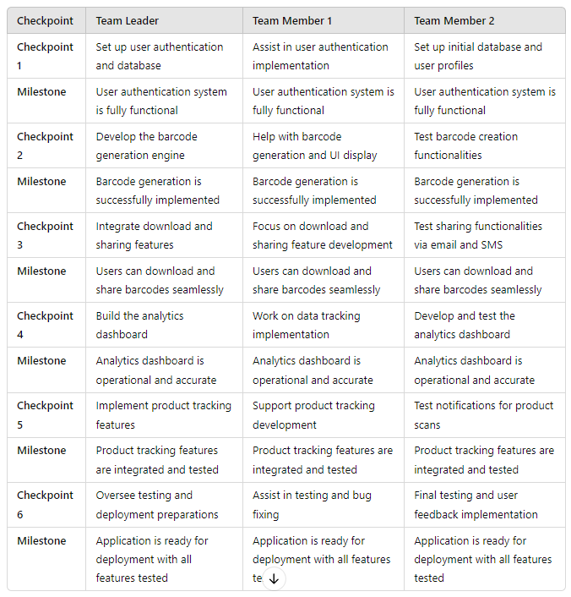
Execution Plan

Slide 6
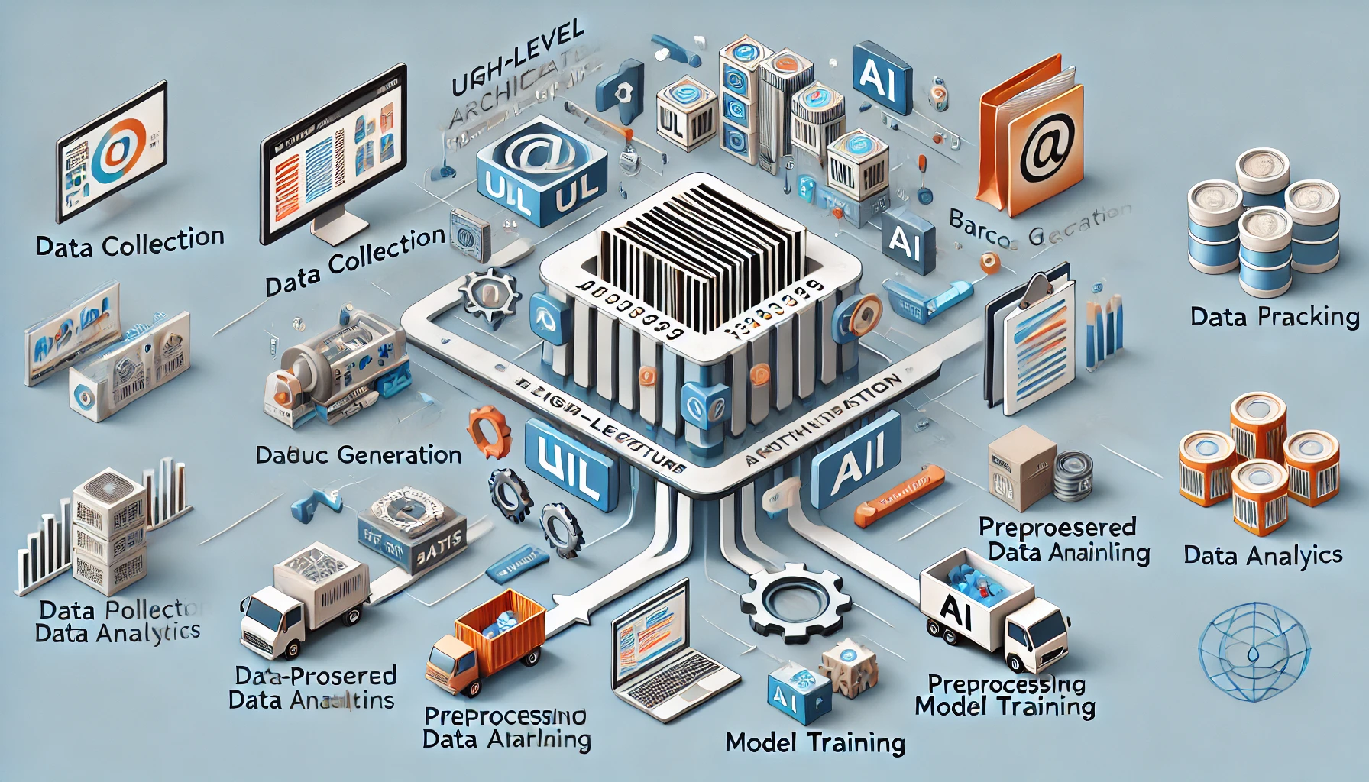
AI Solution Architecture
This diagram shows the key components of a URL barcode creator application. It includes data collection, barcode generation, preprocessing, and AI-powered analytics. Data flows from barcode creation to analysis, enabling real-time product tracking and marketing insights. The AI model improves with model training, and the system is deployed for use in tracking and optimization.

Slide 7
Data Sources(if any)
Inventory Management System:
Description: Software that tracks stock levels, sales, and product movements within the supply chain.
Purpose: Helps monitor real-time product availability and movements associated with the generated barcodes
Data Preprocessing Plans
Data Normalization:
Purpose: Scale data to a uniform range, particularly for numerical values, to ensure fair model training.
Data Cleaning:
Purpose: Remove duplicates, correct errors, and handle missing values to ensure data quality.

Slide 8
Model Selection and Evaluation
LSTM (Long Short-Term Memory) for time-series forecasting:
Reason: LSTM is highly effective for handling long-term dependencies in sequential data, making it ideal for predicting product movement and user engagement trends.
Evaluation Metrics:
Accuracy: Measures how many times the model makes correct predictions (like predicting clicks correctly).
Precision: Shows how many of the predicted clicks were actual clicks (reducing false alarms).

Slide 9
Challenges & Mitigation
Challenges:
Integrating real-time tracking with barcode systems.
Managing large datasets for campaign performance.
Mitigation Strategies:
Use cloud-based data processing to handle scalability.
Employ error handling mechanisms during integration.

Slide 10
Expected Outcomes
Increased efficiency in product tracking.
Improved marketing campaign insights through AI-based analytics.
A scalable system that can be used by businesses of all sizes
.

Slide 11
Conclusion:
This project will deliver a complete solution for URL-based barcode generation and real-time tracking, coupled with AI-powered insights to measure campaign success. We aim to provide businesses with a reliable tool to enhance both their supply chain and marketing strategies.
Additional Support:
Cloud infrastructure for hosting.
Access to additional marketing campaign data for AI training

